Slide 1

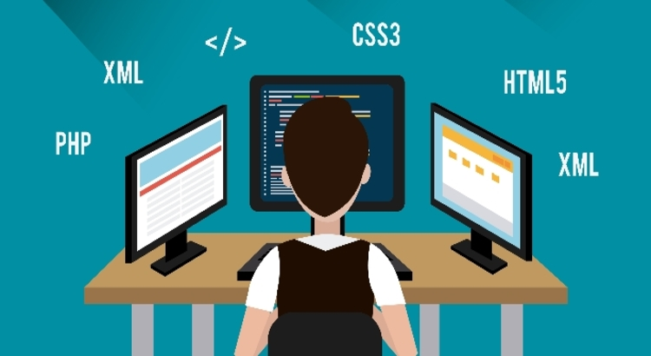
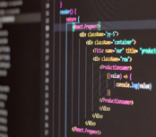
WHY ARE YOU STUDENT A.S.D.
New technologies have become a basic and essential part of human life.
Nowadays, all these advances force us to keep learning constantly, in order to be at the forefront and develop new skills.
ANALYSIS AND SOFTWARE DEVELOPMENT
ENGLISH
AA1 EV03
BROCHURE
THANKS
WHAT IS THE IMPORTANCE OF THE PROGRAM.
I consider that in this program, the students will develop skills in the analysis of real-life situations in order to, through design and programming, find solutions that satisfy the needs of users in different aspects of daily life, such as health, education, transportation, environment, communication, entertainment, and others.
MANUEL PERTUZ PÉREZ
2977343
https://cz.pinterest.com/pin/64598575894031755/

Slide 2



WHAT DO YOU LIKE THE MOST ABOUT THE PROGRAM
There are several reasons why I like the program, but some can be highlighted as :
Working independently and remotely.
The high labor demand in different roles.
Constant development of creativity.
And last but not least, the job offer with the possibility of remuneration in different currencies.
TOMADA DE: hostinger.es/
Tomado de: starkcloud.com
WHY WOULD YOU RECOMMENDED THE PROGRAM
The Technology in Software Analysis and Development program offered by SENA is a comprehensive training program that helps to develop individuals with the ability to integrate technologies, pose and solve problems, thereby developing skills that, from the beginning of their training, can become the spearhead of personal and professional life projects.
INTRODUCTION
Technology Analysis and Software Development, is an educational program offered by SENA, where the apprentice is educated in the process of designing and maintaining programs and applications, in the computer field, that tend to satisfy the needs of users, institutions and organizations.
Tomado de: micarrerauniversitaria.com

